Slide 1
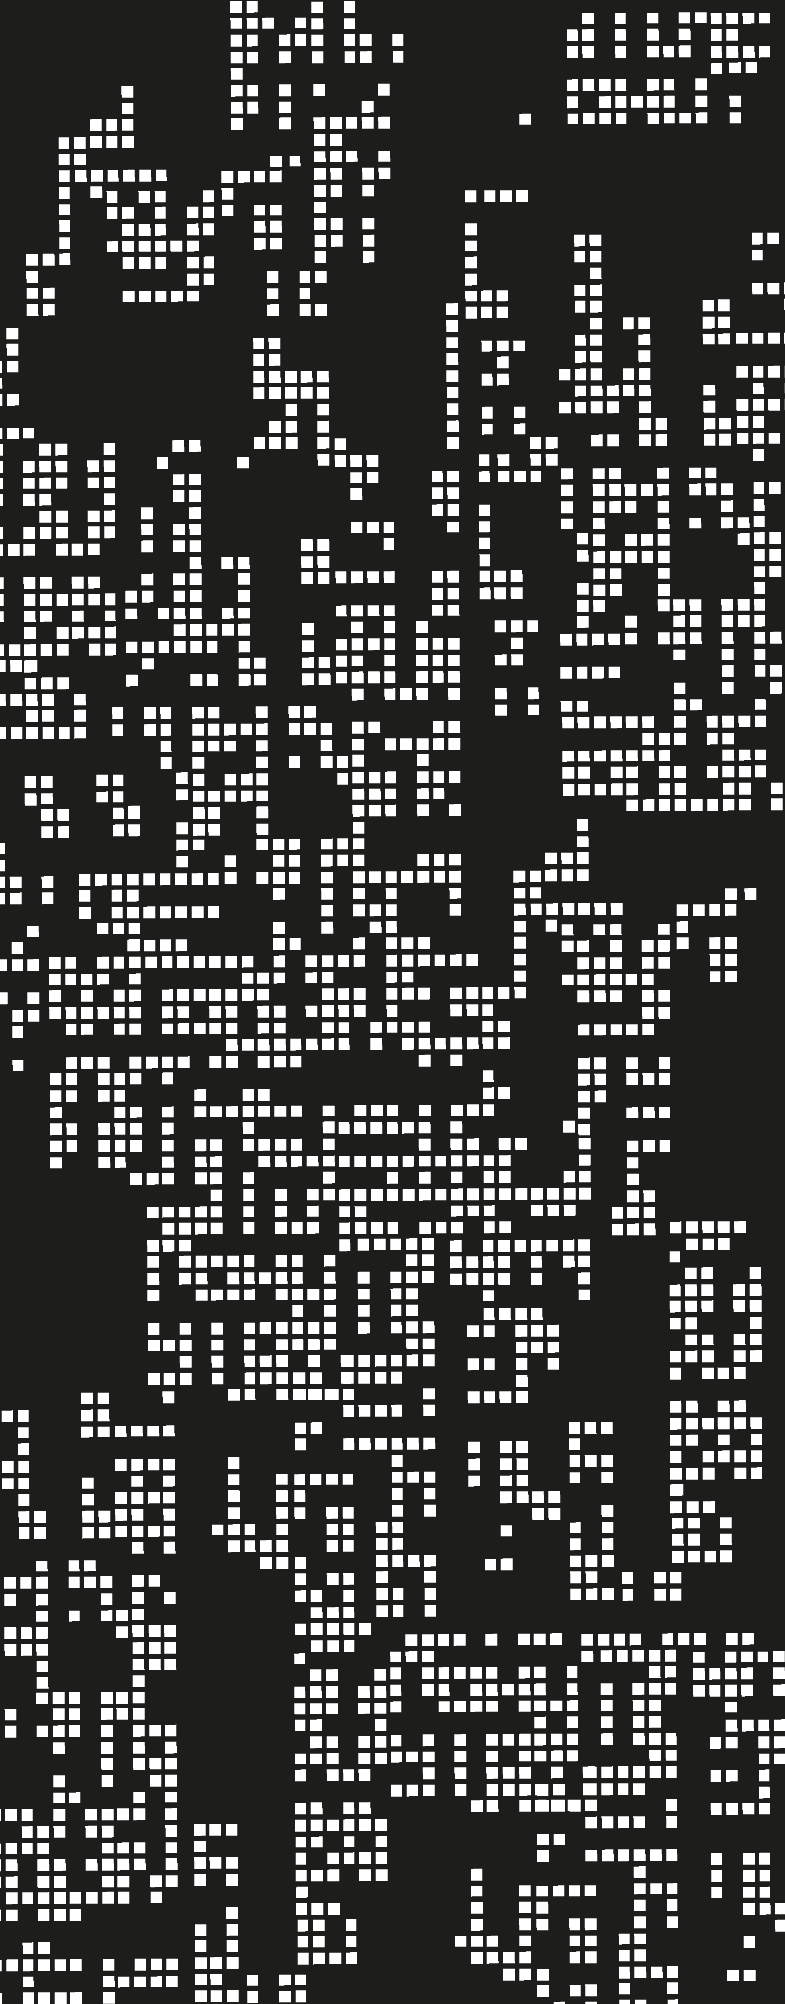
Recursion
3. Tail Recursion

Slide 2
Agenda
01
Recursion & Efficiency
02
Tail Recursion
03
Optimizations

Slide 3
Is recursion …?
Simple
Redundant
Slower
Elegant
Difficult
Heavy
Efficient

Slide 4
Is recursion always slower and more expensive?
Let's consider two cases: factorial and greatest common divisor.
Foreach function, please write the recursive calls until the stopping condition
(define (gcd a b)
(if (zero? b)
a
(gcd b (modulo a b))))
(gcd 14 21)
(define (fact n)
(if (zero? n)
1
(* n (fact (- n 1)))))
(fact 4)

Slide 5
Is recursion always slower and more expensive?
(define (gcd a b)
(if (zero? b)
a
(gcd b (modulo a b))))
(gcd 14 21)
(gcd 21 14)
(gcd 14 7)
(gcd 7 0)
7
(define (fact n)
(if (zero? n)
1
(* n (fact (- n 1)))))
(* 4 (fact 3))
(* 4 (* 3 (fact 2)))
(* 4 (* 3 (* 2 (fact 1))))
(* 4 (* 3 (* 2 (* 1 (fact 0)))))
(* 4 (* 3 (* 2 (* 1 1))))
(* 4 (* 3 (* 2 1)))
(* 4 (* 3 2))
(* 4 6)
24

Slide 6
Is recursion always slower and more expensive?
(define (gcd a b)
(if (zero? b)
a
(gcd b (modulo a b))))
(gcd 14 21)
(gcd 21 14)
(gcd 14 7)
(gcd 7 0)
7
(define (fact n)
(if (zero? n)
1
(* n (fact (- n 1)))))
(* 4 (fact 3))
(* 4 (* 3 (fact 2)))
(* 4 (* 3 (* 2 (fact 1))))
(* 4 (* 3 (* 2 (* 1 (fact 0)))))
(* 4 (* 3 (* 2 (* 1 1))))
(* 4 (* 3 (* 2 1)))
(* 4 (* 3 2))
(* 4 6)
24

Slide 7
Differences on execution profiles
(define (gcd a b)
(if (zero? b)
a
(gcd b (modulo a b))))
(gcd 14 21)
(gcd 21 14)
(gcd 14 7)
(gcd 7 0)
7
(define (fact n)
(if (zero? n)
1
(* n (fact (- n 1)))))
(* 4 (fact 3))
(* 4 (* 3 (fact 2)))
(* 4 (* 3 (* 2 (fact 1))))
(* 4 (* 3 (* 2 (* 1 (fact 0)))))
(* 4 (* 3 (* 2 (* 1 1))))
(* 4 (* 3 (* 2 1)))
(* 4 (* 3 2))
(* 4 6)
24

Slide 8
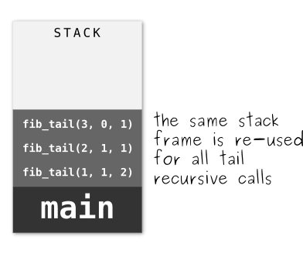
Tail Recursion
(define (gcd a b)
(if (zero? b)
a
(gcd b (modulo a b))))
(gcd 14 21)
(gcd 21 14)
(gcd 14 7)
(gcd 7 0)
7

Slide 9
Summary
References
Tail recursion allows recursion to be efficient on space, optimizations avoid overflows and do a better management of the control context.
PLAI, Chapter 8, 9.
A note on Recursion - E.Tanter

